Slide 1
PROJECT TITLE-INTELLIGENT NOTEPAD
Presented By
Md: Sabbir Ahamed
ID:ASH2225005M

Slide 2
OVERVIEW
Developing a Java Swing-based intelligent Notepad application that includes features such as opening, creating, saving, and editing txt files. The application also integrates spell-checking and next word prediction.

Slide 3

FUNCTI0NALITY
Text Editing : create, edit, and open text file with the editor.
Save : Provide functionality to save a file.
Spell Check and Auto-Correction: Check for misspelled words and offer suggestion for correction.
Next Word Prediction: Predict the next word based on the train data.

Slide 4

Implementation
Spell Check: Checks if a word is incorrect then suggests similar word using Levenshtein distance
Word Prediction: Predicts next words based on unigram, bigram, and trigram frequency maps that trained from a text file.
File Operations: Allows creating, saving, and opening files.
Additional Features:
Editing functions:copy,paste,cut,select all, and find & replace.
Insert Options:Enables inserting the special characters into the document.

Slide 5
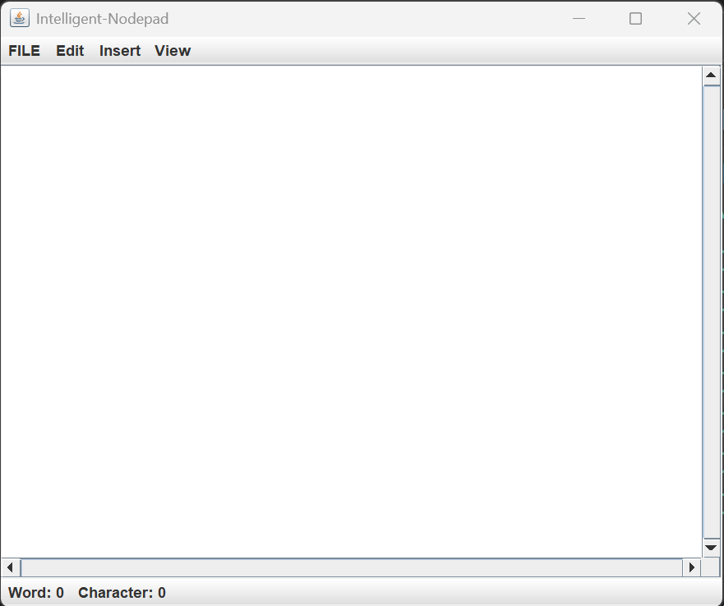

Slide 6
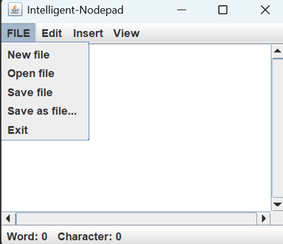
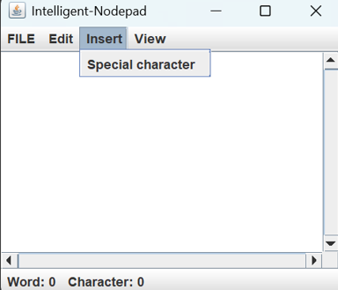
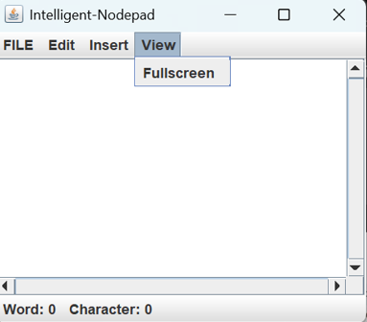
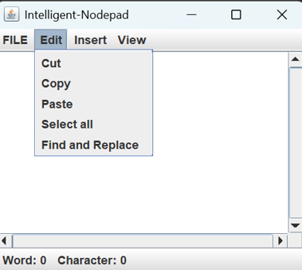

Slide 7
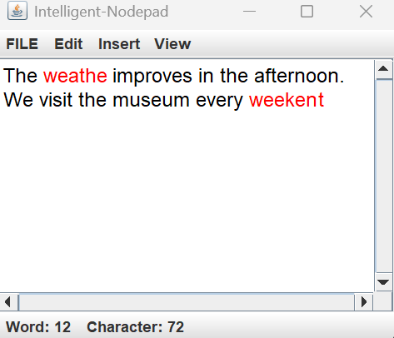
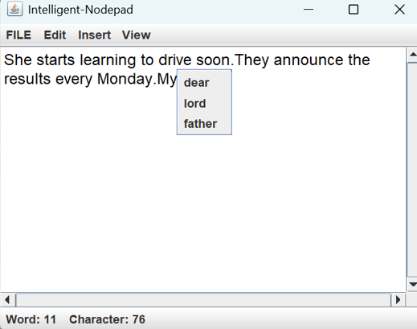

Slide 8

Q/A

